Slide 1
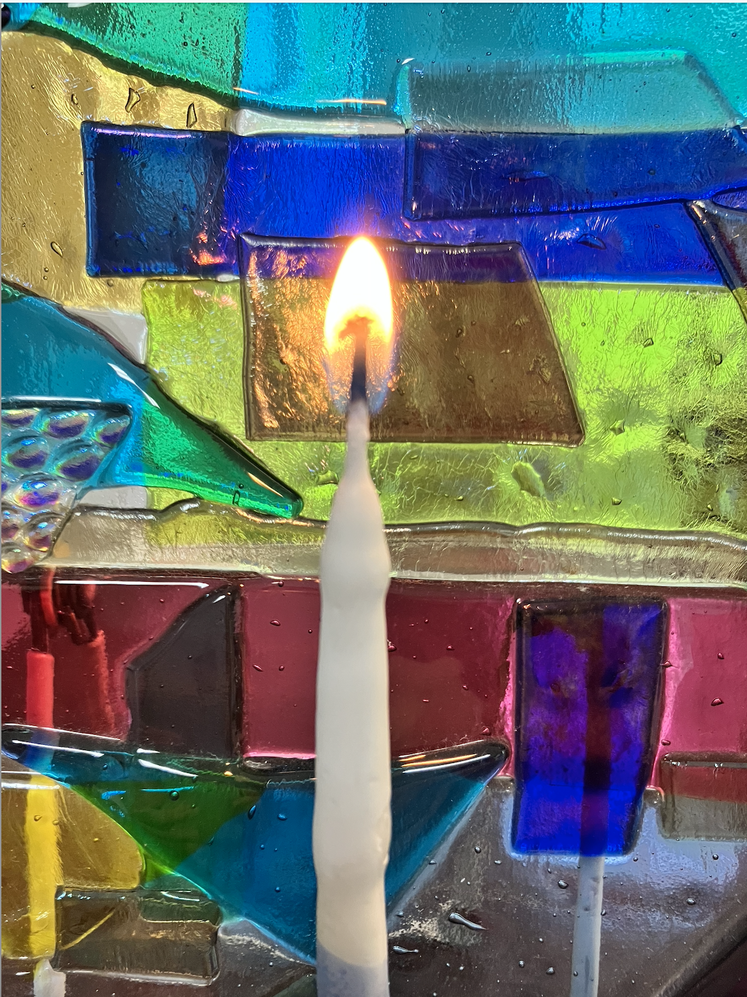
In Memoriam
5784 - 2023
Temple Adath B’nai Israel
Evansville, Indiana

Slide 2
We Remember Them
Rabbi Sylvan Kamens and Rabbi Jack Riemer
In the rising of the sun and in its going down,
we remember them;
In the blowing of the wind and in the chill of winter,
we remember them;
In the opening of the buds and in the rebirth of spring, we remember them;
In the blueness of the sky and in the warmth of summer, we remember them;
In the rustling of the leaves and in the beauty of autumn, we remember them;
In the beginning of the year and when it ends,
we remember them;
When we are weary and in need of strength,
we remember them;
When we are lost and sick at heart,
we remember them;
When we have joys we yearn to share,
we remember them;
So as we live, they too shall live, for they are now a part of us, as we remember them.

Slide 3
In Loving Remembrance of those who have passed away during the past year
Susanna Chastain Elizabeth Caroline Cook
Nellie Dillon
Barbara Doody
Matthew Drake Shirley Jean Gold Bess Levy
Rita Middagh Diana Page Lee Page
Alvrone Sater
Jacquie Shen

Slide 4
In Loving Memory Of
George Neimeth
Nathan and Dora Neimeth
Leo and Pauline Scheer
Mary and Morris Lichtman
Marjorie Bakke
William Bakke
Orville and Beatrice Bakke
Ann and Sam Finkbeiner
Enda and Harold Redfield
Martha and Al Laulainen
Libby Kosalka
Remembered by
Elissa and Tom Bakke
Jordan and Alex Bakke
Debbie and Gail Gray
Elaine Neimeth

Slide 5
In Memory Of
Ben Barancik
Frances Barancik
Maxine Grossman
Harry Grossman
Jerry Barancik
Remembered by
Sue and Martin Barancik
Here the heart is broken, here the spirit enters.
The prayer of a broken heart call the spirit in,
inevitably heal, are therefore whole
~Deena Metzger

Slide 6
In Memory Of
Sadelle Berger
Sydney Berger
August Kaplan
Jerome Kaplan
Jeannette Fino
Abraham Berger
Ruth Berger
Nathan Rechnic
Alina Rechnic
Remembered by
Charles Berger
Blessed are the memories,
holy and cherished the love they reveal.
We pray –
May our sorrows soften and diminish in strength.
May the pain of past bereavements
grow gentler with time.
Let memory bring us
nearer to the loved ones in our midst.
~Mishkan Hanefesh

Slide 7
In Memory Of
Susanna Chastain
Dellas Chastain
Remembered by
Corliss Chastain
There are stars whose light reaches the earth
Only after they themselves have disintegrated.
And there are individuals whose memory
Lights the world after they have passed from it.
These lights shine in the darkest night
And illumine the for us the path
Hannah Senesh

Slide 8
In Memory Of
Hyman G. Dumes
Irene M. Dumes
Jill H. Dumes
Linda Dumes
Denise Dumes Conrad
Cyril Ann Zoll Rosenberg
Reid M. Zoll
Remembered by
Becky Dumes
In Memory Of
William Dumes
Remembered by
Elaine Dumes, Sharon and Steven Marshall, Bob and Kathy Dumes

Slide 9
In Memory Of
Matthew Drake
John Joseph Tarsitano Sr.
John Joseph Tarsitano, Jr.
Paticia Tarsitano
Dale Drake
Cathy Drake
Remembered by
Michael Drake & Nancy Tarsitano
In Memory Of
Max Scharf
Jennie Scharf
Remembered by
Annette and Ray Druley

Slide 10
In Memory Of
Barbara Doody | Wally Shakun
Rita Middagh | June Senzell
Jim Pike | Tom Regan
Larry Dye | Deanna Miller
James Dye | Linda Kramer
Florine Dye | Joe Weiner
Frank Dye | Terry Weiner
Jennie Chase | Bebe Baker
Rachel Senzell | Jean Berger
Jeanette Cibull | Marvin Snyder
Jim Trockman | Hilda Schatz
Ian Schatz | Abe Schatz
Milton Siegel | Lynne Norton
Bob Levi | Bob Green
Gladys Praigrod | Leona Lawitts
Virginal Melvin-Wagner | Mayer Waber
Roz Marver
Remembered By
Sam Dye

Slide 11
In Memory Of
Manny Zendell
Joseph Zendell
June Mattingly Zendell
Remembered by
Nancy and Abe Givon
In Memory Of
Shirley Jean Gold
Remembered by
Bob and Becky Gold
May their memories be a blessing

Slide 12
In Memory Of
Zelda Isaac
Joe Isaac
Molses Dragon
Elsa Dragon
Remembered by
Alan and Helen Isaac
In Memory Of
Julius Korba
Lillian Korba
Ronald Korba
Lawrence Schweitzer
Florence Schweitzer
Remembered by
Eileen Korba

Slide 13
In Memory Of
Louis B Levine
Sarah Levine
Rhea Levine
Evelyn Edith Grace
Remembered by
Irving Levine
In Memory Of
Bonnie Forman
Evelyn Lobel
Jeanette Saper
Leonard Saper
Edith Shanok
Ernie Shanok
Babs Forman
Myron Forman
Albert Lobel
Remembered by
Scott and Dana Lobel

Slide 14
In Memory Of
Nathan and Pauline Lieberman
Abe & Rebecca Lieberman
Max and Ella Hamburg
Philip Hamberg
Robert and Mary Gregg
Robert Gregg Jr
Marianna White
Don Vowells
Don Assalone
Sylvia Weinzapfel
Ann Gregg
Remembered by
Phillip Lieberman
and Mary MacGregor
More Precious was the light in your eyes
then all the roses in the world.
~Edna St. Vincent Millay

Slide 15
In Memory Of
Morton Malitz
Carl Malitz
Evelyn Turner
Sol Turner
Remembered by
The Malitz Family
In Memory Of
Elizabeth Caroline Cook
Jean Berger
Remembered by
Donna G Martin and David Krueger

Slide 16
In Memory Of
Barbara Doody
Thomas Regan
John Regan
Mary Regan
Robert Regan
Doba Mazo
Kelleish Lynch
Remembered by
Gary and Gloria Mazo
In Memory Of
Milton Newman
Rosella Newman
Jack Newman
Barry Newman
Debbie Rhodes
Remembered by
Stanley and Sandra Newman

Slide 17
In Memory Of
Lewis B Newman
Bernice H Newman
Janyt Pockros
Sigmund L Pockros
Carlin Lilly White
Remembered by
Sandy and Alan Newman
We thank you, O God of life and love,
for the resurrecting gift of memory
which endows your children, fashioned in your image,
with the Godlike sovereign power
to give immortality through love.
Praised be you, God, who enables your children to remember.
~ Morris Adler

Slide 18
In Memory Of
Nellie Dillon
Lloyd and Dorotha Dillon
Fred Dillon
David Dillon
Dr. Julian Present
Saul and Lena Present
Remembered by
Mary Present
What we have once enjoyed, we can never lost.
All that we love deeply becomes a part of us.
~Helen Keller

Slide 19
In Memory Of
Ella and Max Hamburg
Hilda and Julian Present
Pauline and Nathan Lieberman
Lena and Saul Present
Philip Hamberg
Remembered by
Phyllis and Andy Present
In Memory Of
Carol Scharf
Eric Scharf
Remembered by
The Scharf Family

Slide 20
In Memory Of
Adele and Albert Abraham
Margo and Jack Seif
Patricia Seif
Mary Charlotte Counter
Remembered by
Lisa Seif and Shirley Seigel
In Memory Of
Sol Silver
Idabelle Silver
Marcia Silver
Remembered by
Don Silver

Slide 21
In Memory Of
I Mayer Wabner
Rachel Wabner
Morris Wabner
Jean Mann Berger
Remembered by
Nancy Wabner
In Memory Of
Alan I Klineman
Sylvia Neff Weinzapfel
Remembered by
Jonathan, Patricia, Nathaniel, Benjamin, and Eleanor Weinzapfel

Slide 22
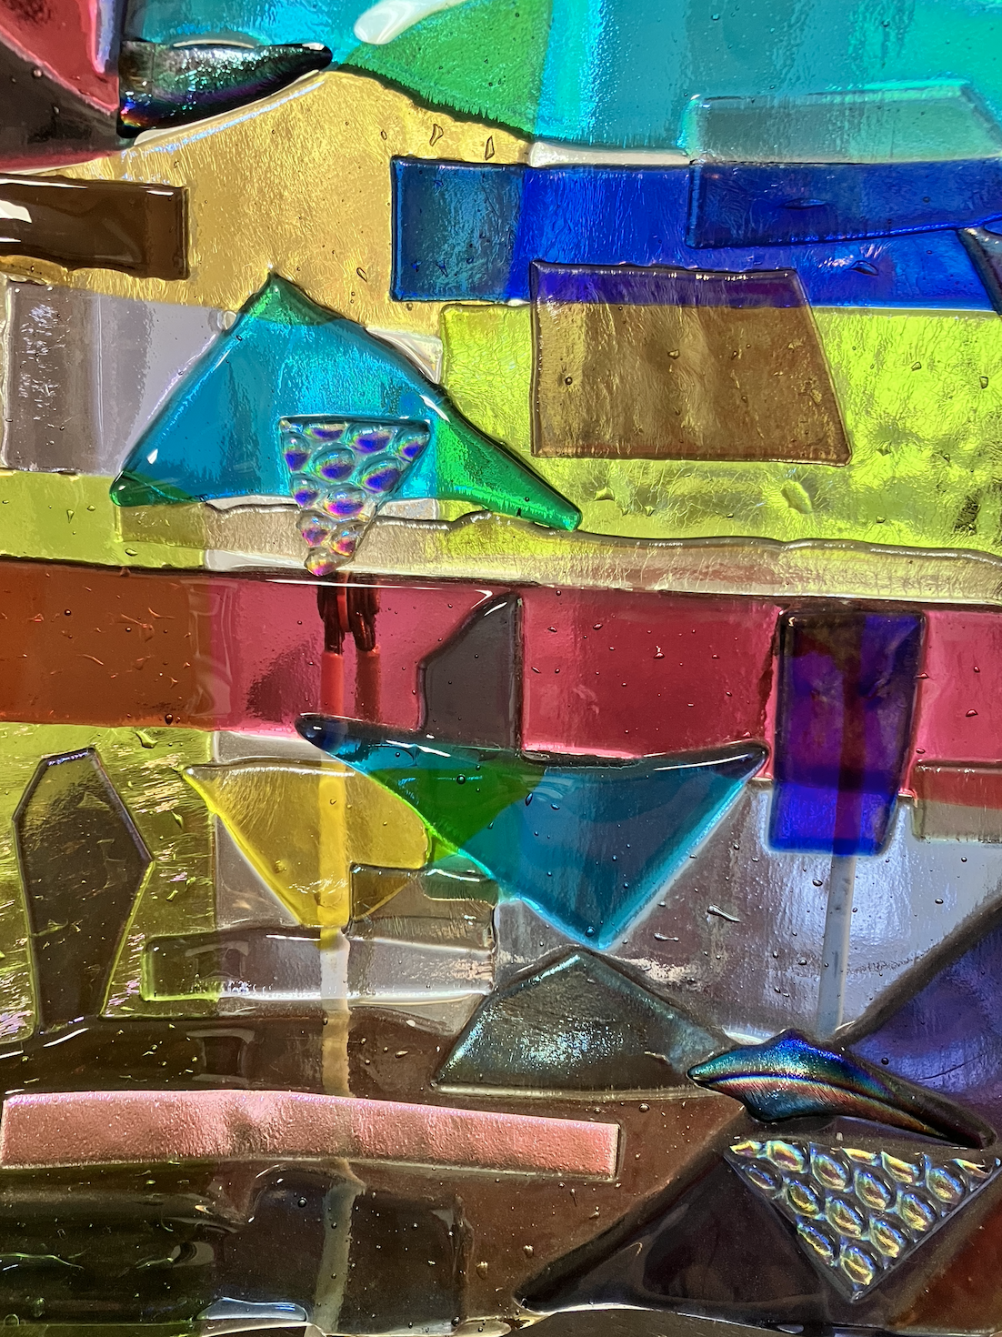

Slide 23
In Memory of a
Father
Mother
Husband
Wife
Daughter
Son

Slide 24
